Slide 1
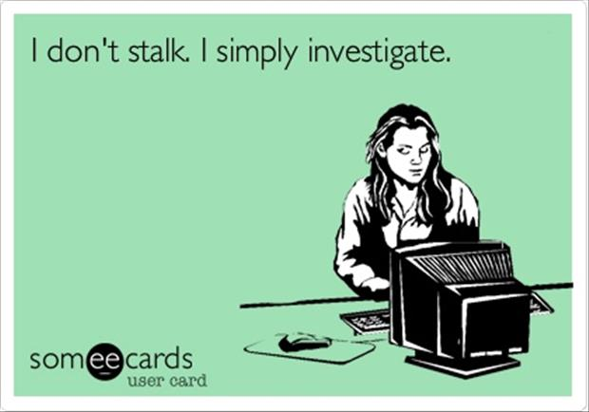
Notes:
Do we enjoy online stalking?

Slide 2
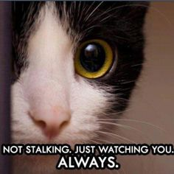
Notes:
Who likes being stalked?

Slide 3
How Amazon uses Big Data to stalk you?
Authors :
Anusha Karunakaran
Chandrashila Chattopadhyay
Lisa Gray
Manasa Krishna
Michelle White

Slide 4
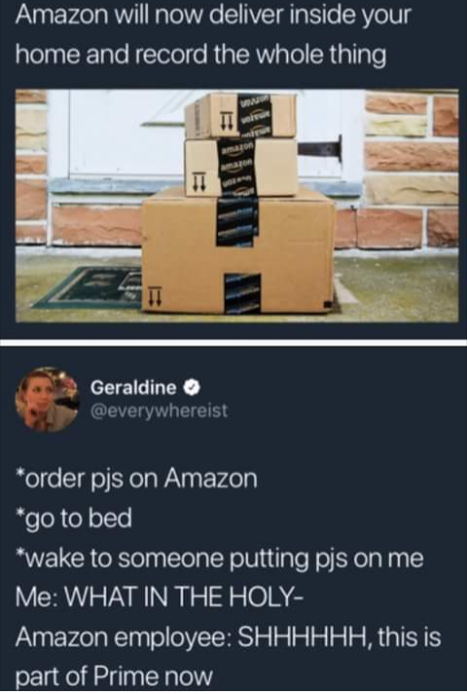

What makes Amazon different?
They know U

Slide 5
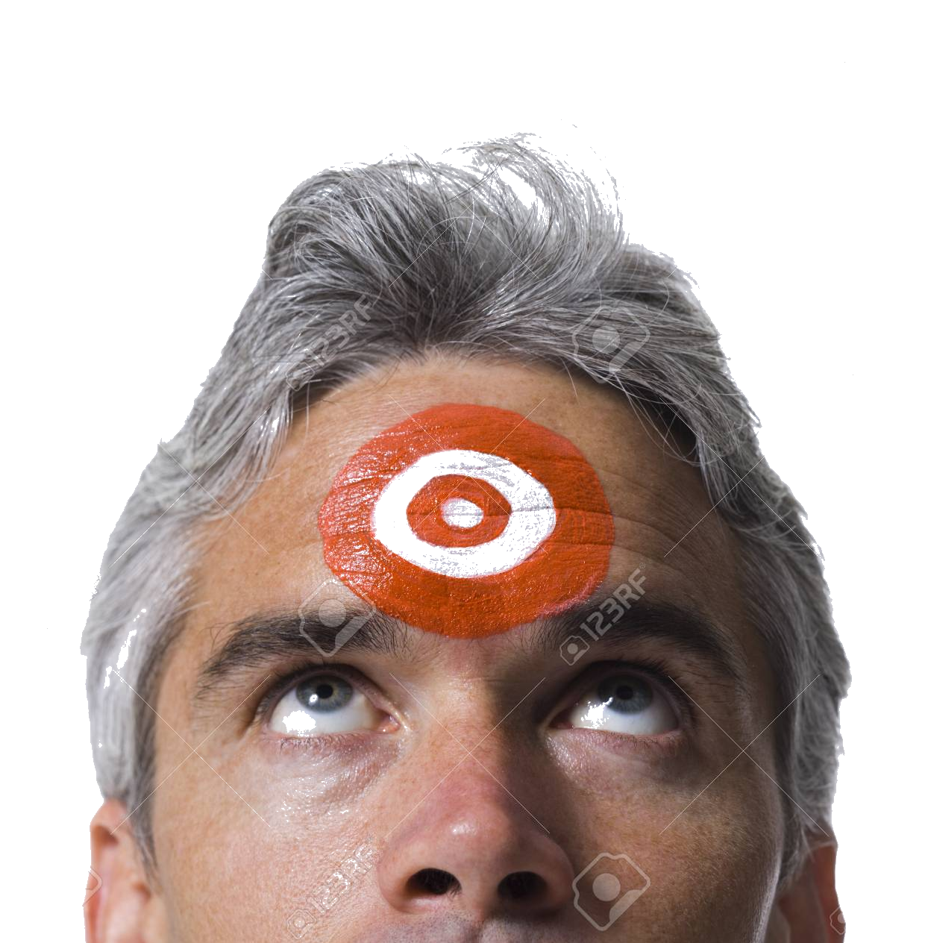
Why does Amazon Stalk its users?
Notes:
they are faster at analyzing your data -
analytics are very personal
the results are directly seen through ads on all webpages
consistent - directed approaches - they know when you are on your email
Amazon.com, Inc. (AMZN) is a leader in collecting, storing, processing, and analyzing personal information from you and every other customer as a means of determining how customers are spending their money.
The company uses predictive analytics for targeted marketing to increase customer satisfaction and build company loyalty.

Slide 6

How does amazon stalk its users

Slide 7








Notes:
market basket analysis - analyzing customer cart
determining associate product recommendations
pros:helping you remember all the items you need/ want ( or didn’t know you even wanted/ needed)
personalized recommendations
cons: watching and analyzing everything thing you do - not only your actions on Amazon

Slide 8



Slide 9

Alexa is Listening
Notes:
notes:
pros: helpful device, enables people to have a smart house - turn on the lights, play music, turn up the heat all without getting off the coach!

Slide 10


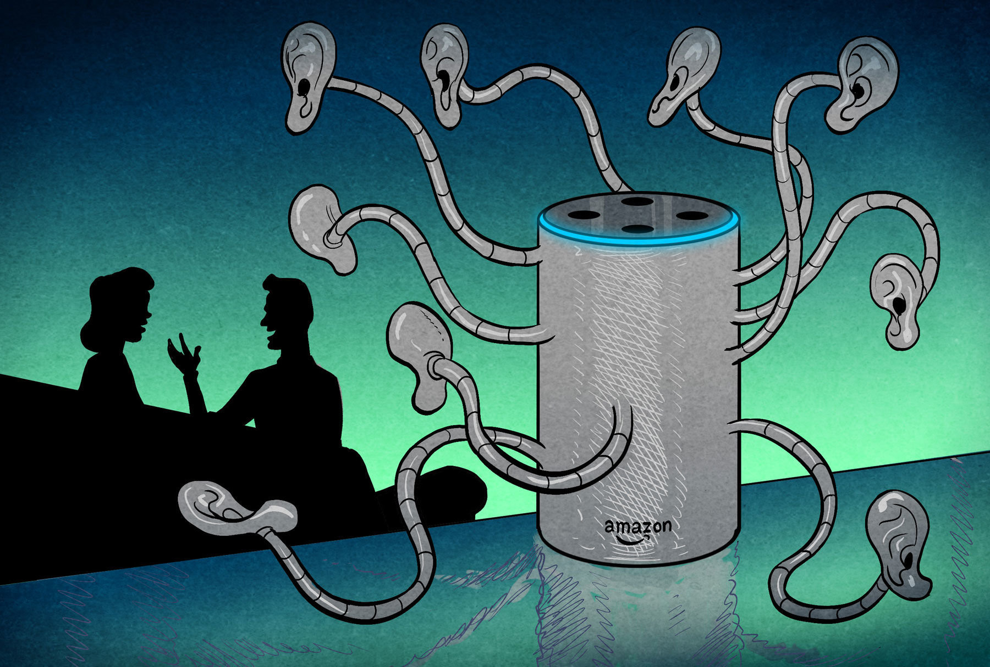
Alexa is Listening ….. Always
Notes:
Amazon admits that its devices like the Echo is listening in as long as the wake word ”Alexa” is used.
Users can view all the conversations that they’ve had with Alexa through a smart phone app. While reviewing this conversation history, many users have found that there were recorded conversations even when the wake word wasn’t used. Imagine having something like your ATM pin or a Social security number being recorded by Alexa. Breach of privacy.

Slide 11



Feeling Creeped Out?!

Slide 12




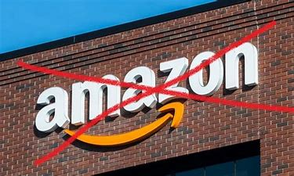
How to Stop Amazon Stalking
Notes:
Michelle White
https://www.techuntold.com/stop-amazon-ads-related-searches-other-websites/
stop using amazon
specify your ad preferences - Account —> Personalisation —> Advertising preferences —> Do not Personalize Ads from Amazon for this Internet Browser
stop using google - go incognito
clear cookies and preferences
clear browser history

Slide 13

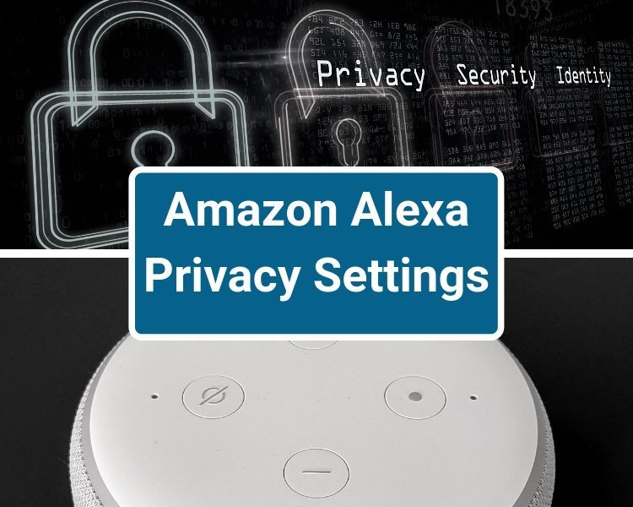


Slide 14
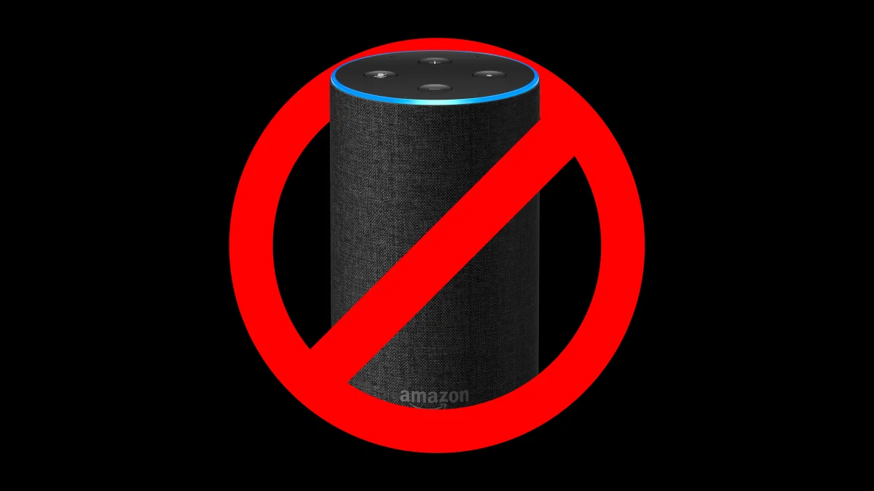
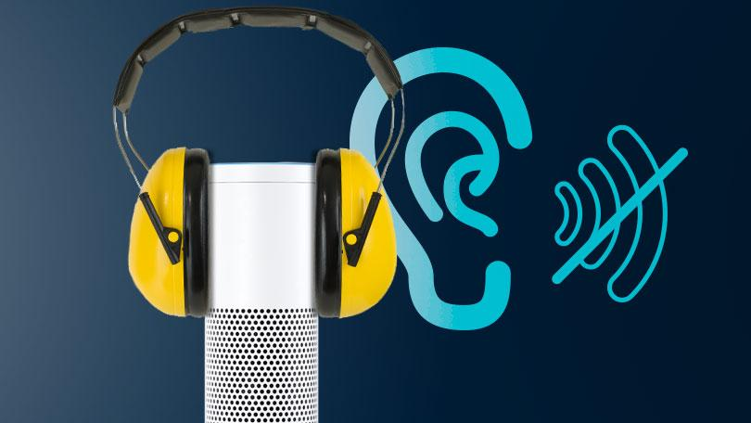
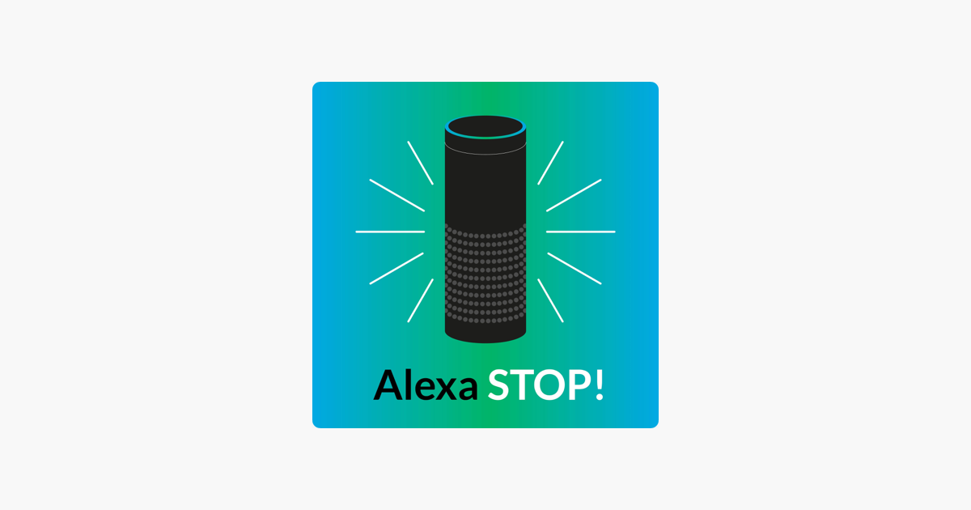

How to Stop Amazon Echo from Stalking
Notes:
Michelle White
https://www.techuntold.com/stop-amazon-ads-related-searches-other-websites/
unplug your smart devices and remove alexa app from phone
update your preferences - to prevent them from using your data to improve their products
change the device to delete recording after 3 or 18 months
turn off Alexa’s microphone (activate / deactivate when you do not want it listening)
turn off ‘drop - in’ settings (allows you to use an elexa or Echo as an intercom with other the other user having to pick up the call)

Slide 15


Slide 16
References
https://www.investopedia.com/articles/insights/090716/7-ways-amazon-uses-big-data-stalk-you-amzn.asp
https://www.techuntold.com/stop-amazon-ads-related-searches-other-websites/
https://blogs.wsj.com/digits/2014/01/17/amazon-wants-to-ship-your-package-before-you-buy-it/

